Slide 1
Memory Hierarchy

Slide 2
Principal of locality
Temporal Locality
If an item is referenced, it will tend to be referenced again
Spatial Locality
If an item is referenced, items close by will tend to be referenced.

Slide 3
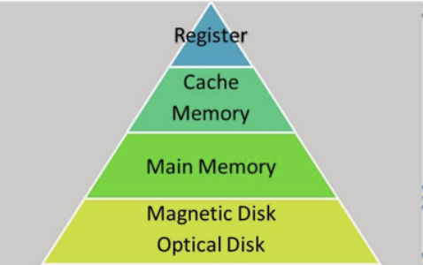
Memory Hierarchy
Takes Advantages of Locality
Everything on Disk
Copy form disk to smaller DRAM : main memory
Copy form DRAM to smaller SRAM : cache
Notes:
Dynamic random access meory, Static random access memory,

Slide 4
Memory Hierarchy
It is a structure
Uses multiple levels of memories
Distanced from processor
As the distance from processor increase
The size increases
Speed reduced
Cost reduced
Access time increases

Slide 5
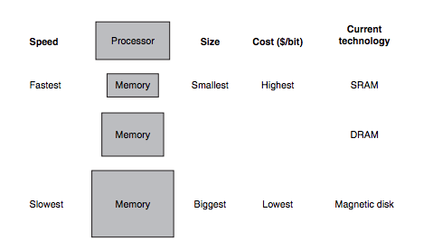
Basic Structure of Memory Hierarchy

Slide 6
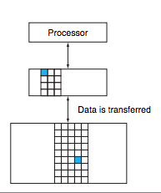
Memory Hierarchy
Data is also hierarchical
L1 < L2
At a time data is copied
Between only two adjacency
levels

Slide 7
Some Terminologies
A Block or Line
Minimum unit of information that can be presented or not presented
Hit
Data Requested by the processor found in the upper level
Miss
Data is not found it the upper level
The lower level is accessed to get the data

Slide 8
Some Terminologies…..
Hit rate or hit ratio
Hit/access
It is often used to measure the performance
Miss rate
1 – hit rate
The time to service hit and miss is important
Hit times
Time to access the upper level
Time needed to determine a hit or a miss

Slide 9
Some Terminologies…..
Miss Penalty
Time to replace a block in upper level with a corresponding block in the lover level
Plus the time to deliver it to the processor

Slide 10
The Basic of Caches
Cache:
A safe place for hiding or storing things.
Simple Cache
Processor requests are each one words
Blocks also consists of a single word

Slide 11
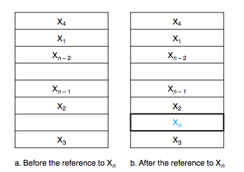
Simple Cache

Slide 12
Two Questions?
How do we know if a data item is in the cache?
How do we find it?
By using the concept direct map

Slide 13
Direct Map
Each word can go exactly at one place in the cache
Assign the cache location base on the address of the word in memory
This cache structure is called direct mapped cache

Slide 14
Mapping?
Larger amount need to map with smaller amount
Lets do an example
8 – block cache = 2³
Memory address 1_{ten} (00001_{two}) – 31_{ten} (11111_{two})

Slide 15
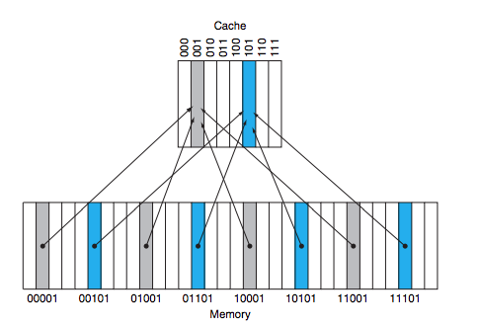
Direct Map (Index)

Slide 16
Multiple data in single place!
How do we know data corresponds to a requested word?
By using a set of tags
Tags
Contains the address information to identify a word
Upper portion of the word address
Upper 2 of the 5 bits address

Slide 17
Valid bit
Valid bit checks where this index had any data or not

Slide 18
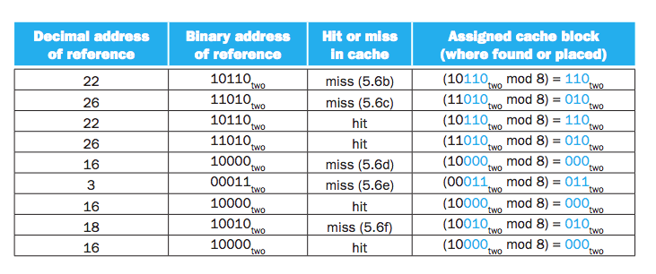
Accessing a Cache

Slide 19
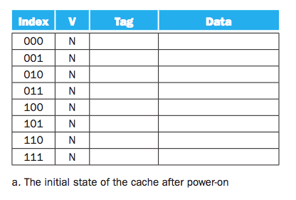
Accessing a Cache

Slide 20
Accessing a Cache

Slide 21
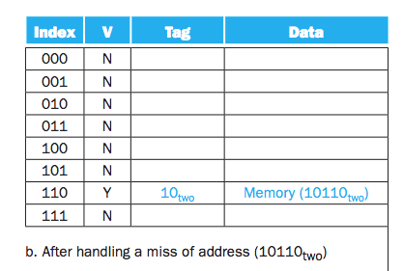
Accessing a Cache

Slide 22
Accessing a Cache

Slide 23
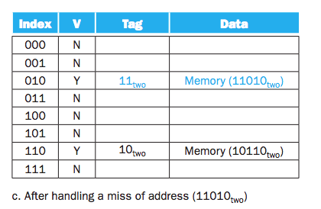
Accessing a Cache

Slide 24
Accessing a Cache

Slide 25
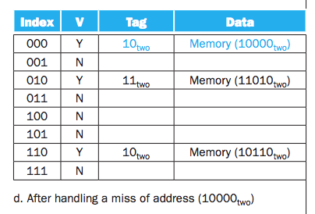
Accessing a Cache

Slide 26
Accessing a Cache

Slide 27
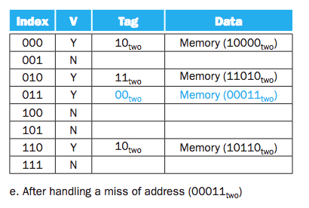
Accessing a Cache

Slide 28
Accessing a Cache

Slide 29
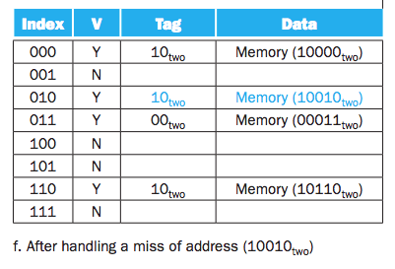
Accessing a Cache

